Slide 1
Word Embedding Tools and Frameworks

Slide 2
Introduction to Word Embeddings
Dense vector representations of words capturing semantic meaning.
Importance in NLP for tasks like classification, translation, and sentiment analysis.

Slide 3
Categories of Word Embeddings
Prediction-based embeddings: Word2Vec, FastText
Count-based embeddings: GloVe
Contextual embeddings: mBERT (based on Transformers)

Slide 4
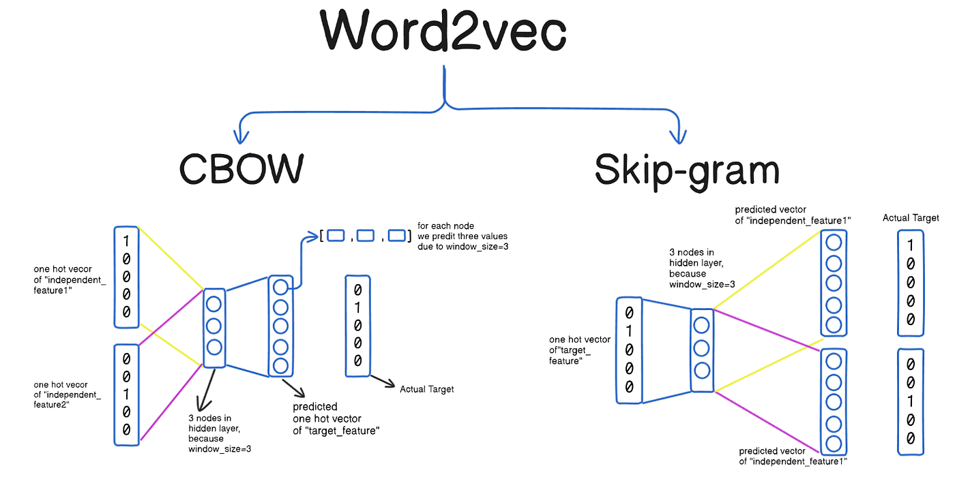
Word2Vec
Mikolov et al. (2013) introduced Word2Vec, a neural network model to produce word embeddings capturing semantic and syntactic word relationships.
It has two main architectures:
Continuous Bag of Words
Skip – gram
Methodology: Shallow neural nets trained on large corpora using local context windows.
Source: https://medium.com/@fraidoonomarzai99/word2vec-cbow-skip-gram-in-depth-88d9cc340a50

Slide 5
Results: Efficient embeddings that significantly improved tasks like analogy completion and text classification
Reference: Mikolov, T., Sutskever, I., Chen, K., Corrado, G. S., & Dean, J. (2013). Efficient Estimation of Word Representations in Vector Space. arXiv preprint arXiv:1301.3781.

Slide 6
GloVe
Pennington et al. (2014) proposed GloVe, which constructs embeddings by factorizing a word co-occurrence matrix representing the global corpus statistics.
GloVe balances global matrix information with local context to create meaningful embeddings.
Methodology: Matrix factorization optimizing on log word co – occurrence probabilities for vector derivation.

Slide 7
Results: Produces embeddings that outperform traditional models on analogy and phrase tasks.
Limitations: Like Word2Vec, embeddings are static and lack contextual nuance.
Reference: Pennington, J., Socher, R., & Manning, C. D. (2014). GloVe: Global Vectors for Word Representation. In Proceedings of the 2014 Conference on Empirical Methods in Natural Language Processing (EMNLP) (pp. 1532-1543).

Slide 8

FastText
Bojanowski et al. (2016) extended Word2Vec by embedding words as bag of character n-grams, enabling the model to capture sub-word information.
Improves representation of rare and morphologically complex words.
Methodology: Integrates subword information in embeddings with skip – gram training.

Slide 9
Results: Improved performance on rare word and language morphology – sensitive tasks.
Limitations: Still static embeddings and higher computational cost relative to Word2Vec.
Reference: Bojanowski, P., Grave, E., Joulin, A., & Mikolov, T. (2016). Enriching Word Vectors with Subword Information. arXiv preprint arXiv:1607.04606.

Slide 10
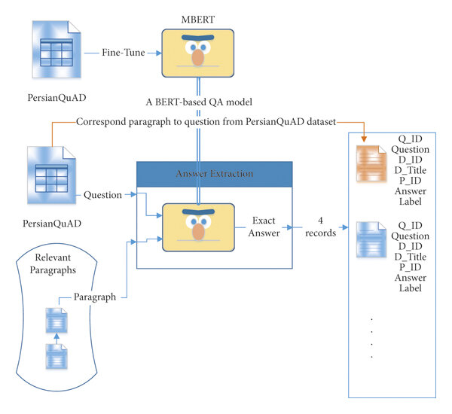
mBERT
Devlin et al. (2018) introduced BERT, a transformer-based model generating deep, contextual embeddings. mBERT is trained on 104 languages, facilitating cross-lingual tasks.
Unlike static embeddings, mBERT produces context-sensitive representations for each word occurrence.
Methodology: Pretraining uses masked language modeling and next sentence prediction in a deep transformer architecture. Fine – tuning adapts pretrained weights for specific tasks like sentiment analysis.

Slide 11
Results: State – of – the – art on many NLP tasks, robust multilingual transfer learning.
Limitations: Large model size, requiring substantial computation resources.
Reference: Devlin, J., Chang, M.-W., Lee, K., & Toutanova, K. (2018). BERT: Pre-training of Deep Bidirectional Transformers for Language Understanding. arXiv preprint arXiv:1810.04805.

Slide 12
Comparative Analysis Table
Feature | Word2Vec | GloVe | FastText | mBERT
Model Type | Predictive | Count – based | Predictive + Subword | Transformer – based
Handles OOV | No | No | Yes | Yes
Contextual Embeddings | No | No | No | Yes
Training Data Requirement | Large Corpus | Large Corpus | Large Corpus | Very large Multilingual Corpus
Typical use | Semantic similarity, embeddings | Semantic similarity | Morphologically rich languages | Contextual language understanding

Slide 13
Applications of Word Embeddings
Text Classification
Sentiment Analysis
Name Entity Recognition
Machine Translation
Question Answering and Dialogue Systems

Slide 14
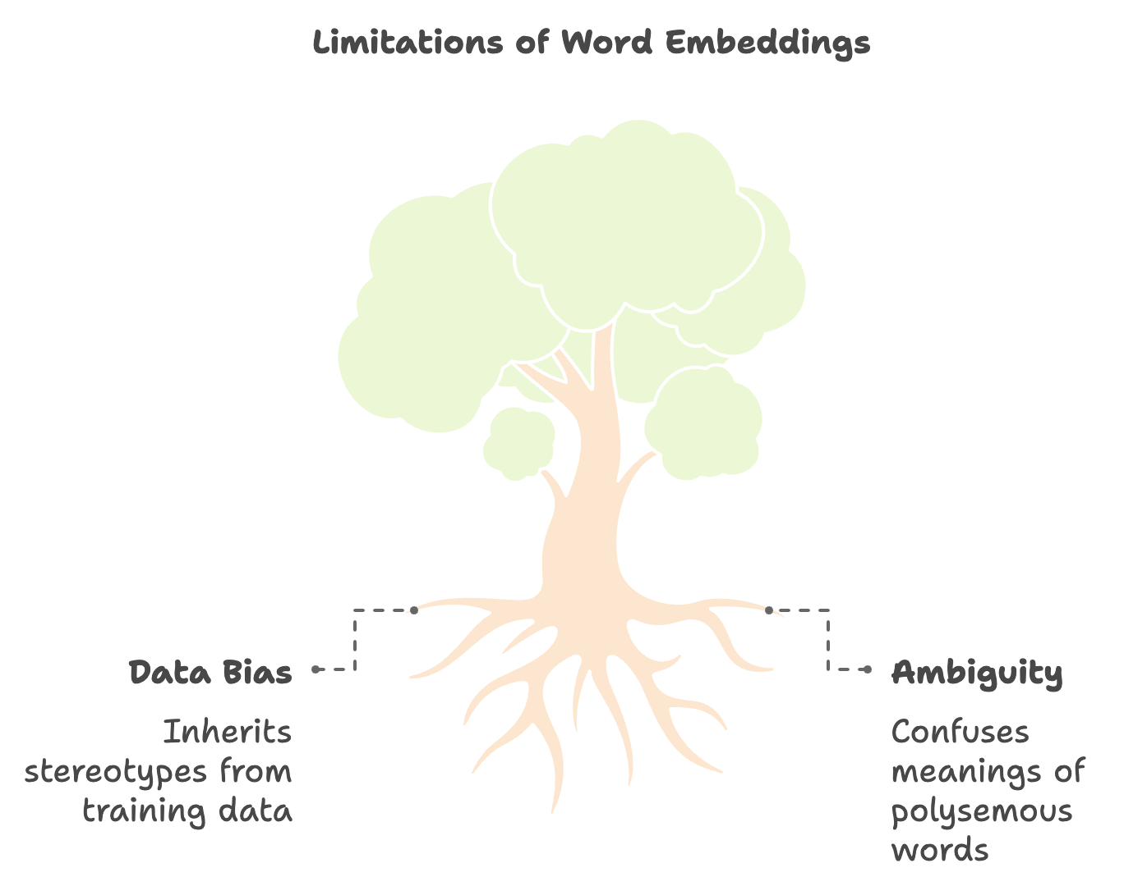
Challenges and Limitations
Out – of – Vocabulary and rare word issues
Static vs dynamic embeddings
Multilingual and low – resource language support
Biases inherited from training data

Slide 15
Research Directions
Hybrid models combining static and contextual embeddings
More efficient training methods for large – scale models
Embedding interpretability and bias mitigation
Cross – lingual and domain adaption techniques

